Slide 1

University of North Texas
CSCE 2110
Foundations of Data Structures
Sorting

Slide 2
Content
Comparison-based sorting algorithms:
Insertion sort
Selection sort
Heapsort
Merge sort
Quick sort
Integer sorting (optional):
Bucket sort
Radix sort

Slide 3
Sorting
Given a set (container) of 𝑛 elements:
e.g., array, set of words, etc.
Suppose there is an order relation that can be set across the elements
Goal: Arrange the elements in a certain order
e.g., ascending/descending orders

Slide 4
Sorting
Given a set (container) of 𝑛 elements:
e.g., array, set of words, etc.
Suppose there is an order relation that can be set across the elements
Goal: Arrange the elements in a certain order
e.g., ascending/descending orders
Before sorting: 1 23 2 56 9 8 10 100

Slide 5
Sorting
Given a set (container) of 𝑛 elements:
e.g., array, set of words, etc.
Suppose there is an order relation that can be set across the elements
Goal: Arrange the elements in a certain order
e.g., ascending/descending orders
Before sorting: 1 23 2 56 9 8 10 100
After sorting: 1 2 8 9 10 23 56 100

Slide 6
Importance of Sorting
Why don’t CS profs ever stop talking about sorting?
Computers spend a lot of time sorting, historically 25% on mainframes
Sorting is the best studied problem in computer science, with many different algorithms known
Most of the interesting ideas we will encounter in the course can be taught in the context of sorting, such as divide-and-conquer, randomized algorithms, and lower bounds

Slide 7
Stable Sorting
A property of sorting
If a sort guarantees the relative order of equal items stays the same, then it is a stable sort
Before sorting: 7₁, 6, 7₂, 5, 1, 2, 7₃, -5 (subscripts added for clarity)
After sorting: -5, 1, 2, 5, 6, 7₁, 7₂, 7₃ (result of stable sort)

Slide 8
In Place Sorting
Sorting of a data structure does not require any external data structure for storing the intermediate steps
The amount of extra space required to sort the data is constant with the input size

Slide 9
Insertion Sort
Insertion sort: orders a list of values by repetitively inserting a particular value into a sorted subset of the list
More specifically:
consider the first item to be a sorted sub list of length 1
insert the second item into the sorted sub list, shifting the first item if needed
insert the third item into the sorted sub list, shifting the other items as needed
repeat until all values have been inserted into their proper positions

Slide 10
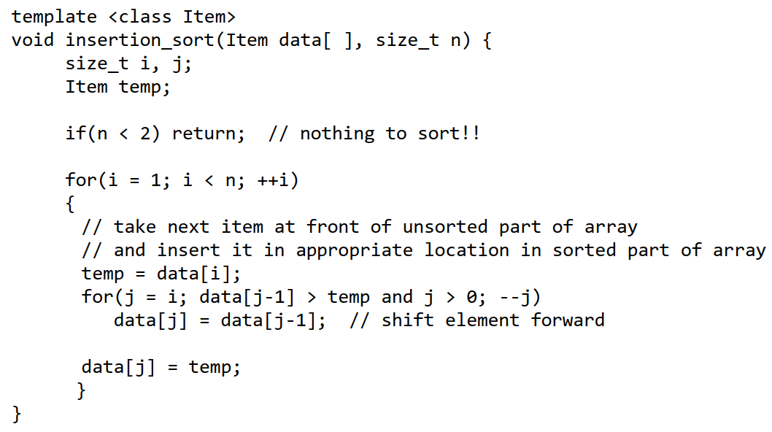
Insertion Sort

Slide 11
Insertion Sort: Example
Sorting: 3, 9, 6, 1, 2 using insertion sort

Slide 12
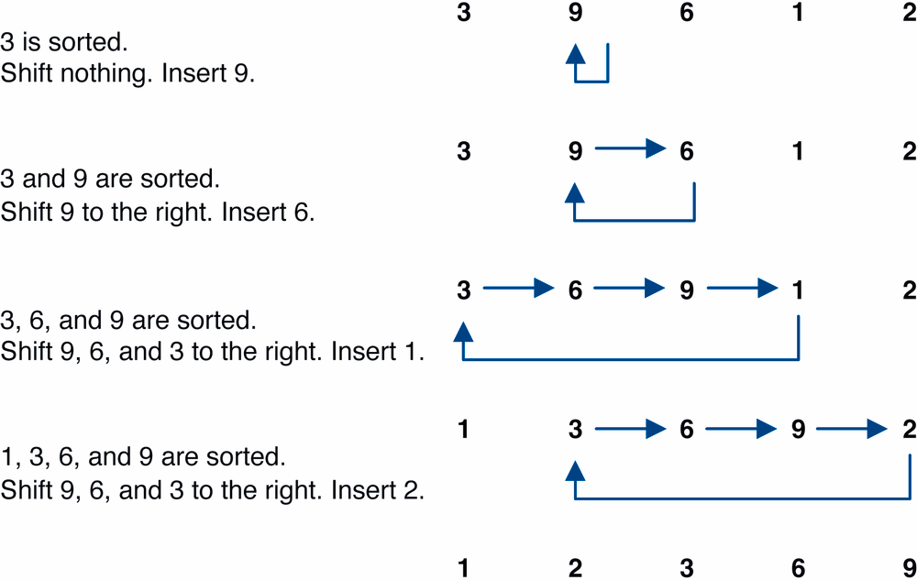
Insertion Sort: Example
Sorting: 3, 9, 6, 1, 2 using insertion sort

Slide 13
Insertion Sort Time Analysis
In 𝑂-notation, what is:
Worst case running time for 𝑛 items?
Best case running time for 𝑛 items?

Slide 14
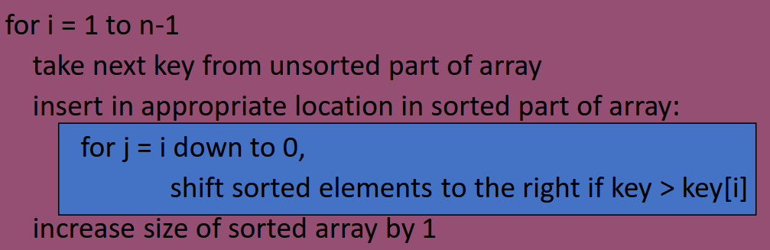
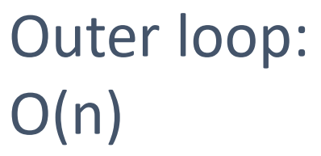
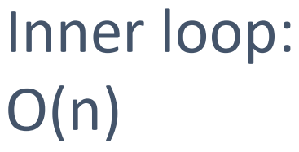
Insertion Sort Time Analysis
In 𝑂-notation, what is:
Worst case running time for 𝑛 items?
Best case running time for 𝑛 items?
Steps of algorithm:

Slide 15
Selection Sort
Basic idea:
Find the smallest element in the array
Exchange it with the element in the first position
Find the second smallest element and exchange it with the element in the second position
Continue until the array is sorted

Slide 16
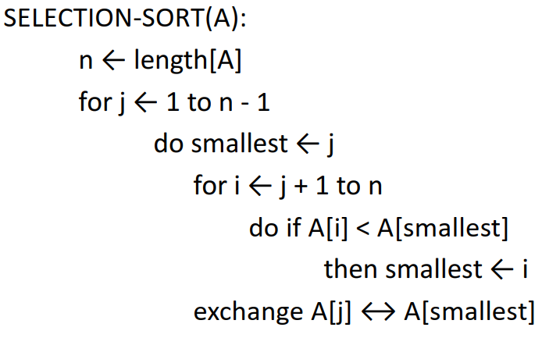
Selection Sort

Slide 17
Selection Sort: Example
Sorting: 8, 4, 6, 9, 2, 3, 1 using selection sort

Slide 18









Selection Sort: Example
Sorting: 8, 4, 6, 9, 2, 3, 1 using insertion sort

Slide 19
Selection Sort Time Analysis
It's clearly quadratic:
The first pass, we search through exactly 𝑛 − 1 elements (no difference between average-case and worst-case), then swap (constant time)
Second time, 𝑛 − 2 elements, then 𝑛 − 3, etc.
We get the arithmetic sum (n-1)+(n-2)+(n-3)+…+1= O(n²)

Slide 20
Heapsort
Sorting Strategy:
Build Max Heap from unordered array;
Find maximum element 𝐴[1];
Swap elements 𝐴[𝑛] and 𝐴[1]: now max element is at the end of the array!
Discard node 𝑛 from heap (by decrementing heap-size variable)
New root may violate max heap property, but its children are max heaps. Run max_heapify to fix this.
Go to Step 2 unless heap is empty.

Slide 21
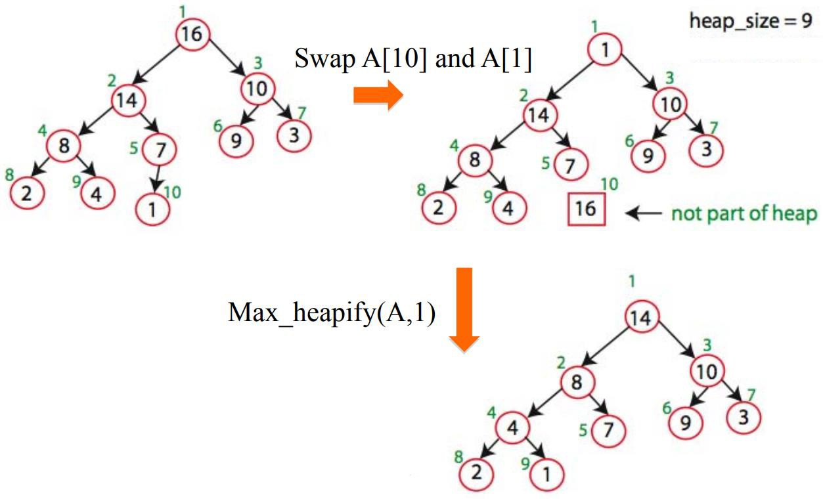
Heapsort Demo

Slide 22
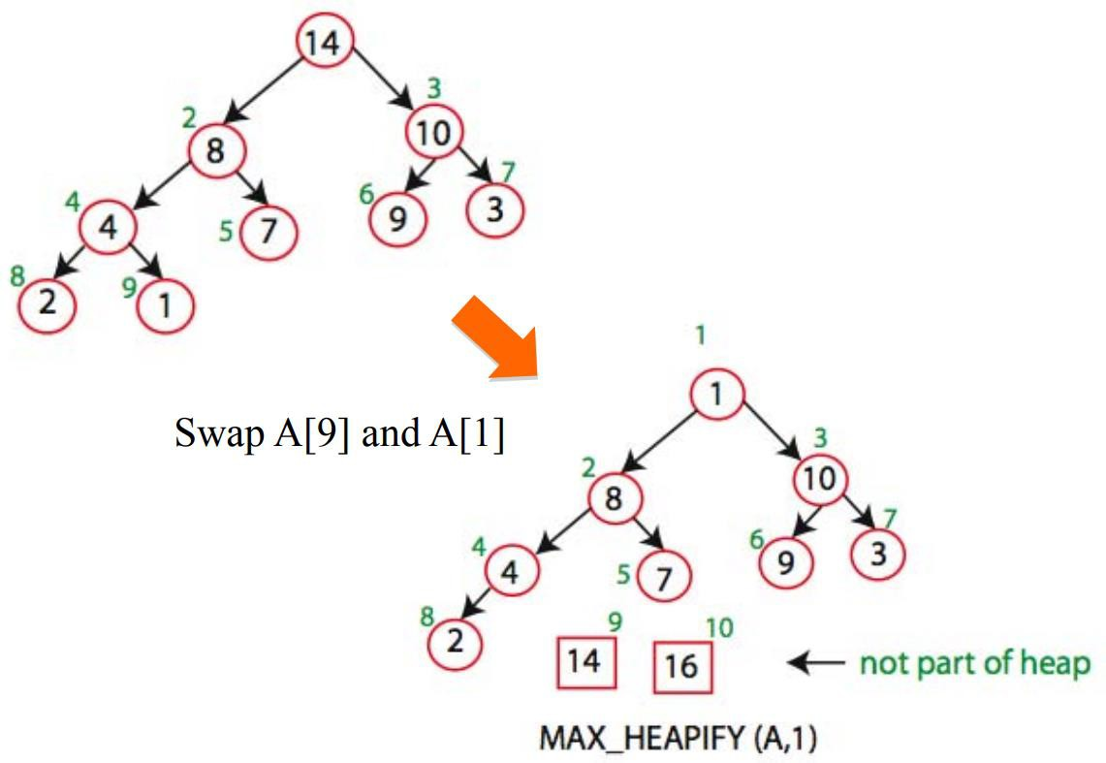
Heapsort Demo

Slide 23
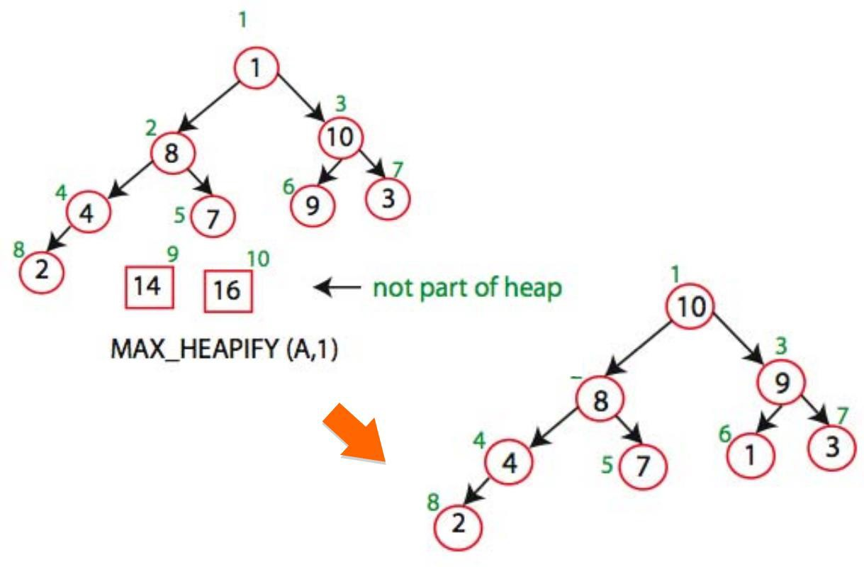
Heapsort Demo

Slide 24
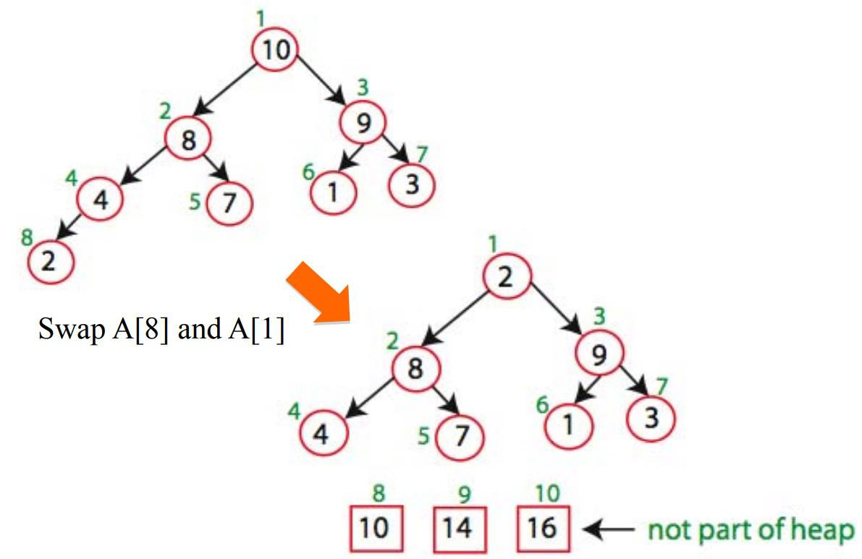
Heapsort Demo

Slide 25
Heapsort Time Analysis
After 𝑛 iterations the Heap is empty
Every iteration involves a swap and a max_heapify operation;
Hence it takes O(𝑛 log 𝑛) time overall

Slide 26
Divide and Conquer
Very important technique in algorithm design
Divide problem into smaller parts
Independently solve the simpler parts
Think recursion
Or potential parallelism
Combine solution of parts to produce overall solution
Two great sorting methods are fundamentally Divide-and-Conquer:
Merge Sort
Quick Sort

Slide 27
Merge Sort
So simple — really, soooooo simple
Split the array into two halves
Sort (using the same merge sort) the first half
Then, sort the second half
Then, merge them (since they are ordered sequence, it should be easy to merge them in linear time into a single ordered sequence)

Slide 28
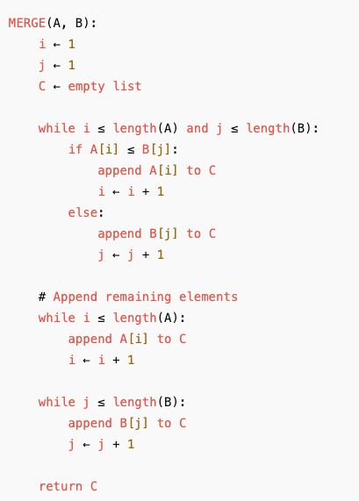
Merging Operation

Slide 29
Merge Sort
Merging two sorted sequences into a single sorted sequence (in linear time):
Example:
Sequence A: 11, 23, 40, 57, 78, 93
Sequence B: 5, 9, 35, 36, 39, 63
How to merge?

Slide 30
Merge Sort
Sorting 38, 27, 43, 3, 9, 82, 10 using merging sort

Slide 31
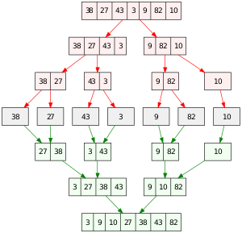
Merge Sort
Sorting 38, 27, 43, 3, 9, 82, 10 using merging sort

Slide 32
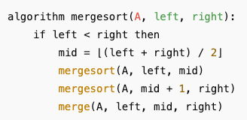
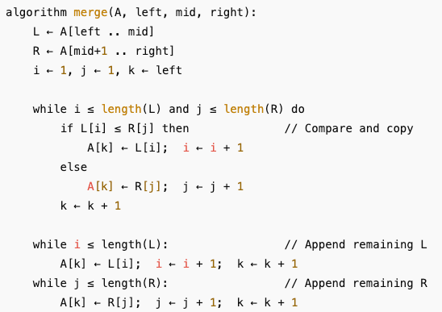
Merge Sort

Slide 33
Quick Sort
Pick a “pivot” p (the pivot is a number in the list)
Divide list into two sublists
One less-than-or-equal-to pivot value
One greater than pivot value
Sort each sub-problem recursively
Answer is the concatenation of the two solutions
p
p
numbers less than or equal to p
numbers greater than p

Slide 34
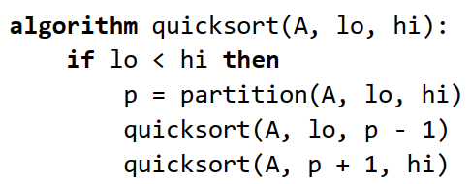
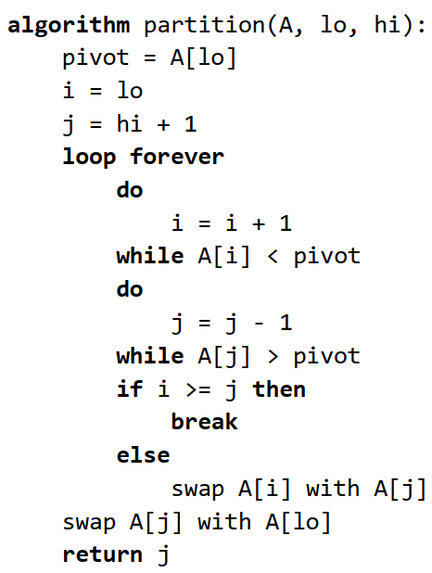
Quick Sort Pseudocode
First element is the pivot

Slide 35
Quick Sort: Example
Sorting 7, 2, 8, 3, 5, 9, and 6 using quick sort

Slide 36
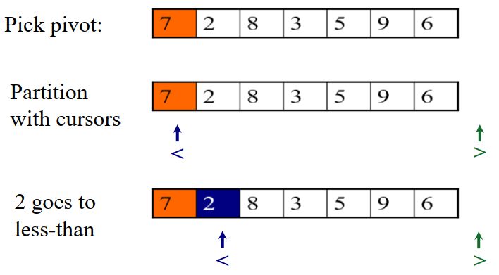
Quick Sort: Example
Sorting 7, 2, 8, 3, 5, 9, and 6 using quick sort

Slide 37
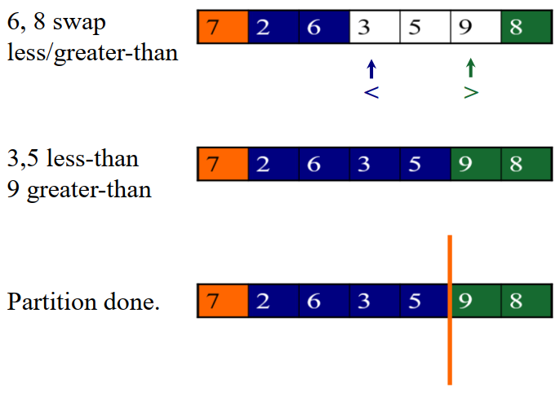
Quick Sort: Example
Sorting 7, 2, 8, 3, 5, 9, and 6 using quick sort

Slide 38
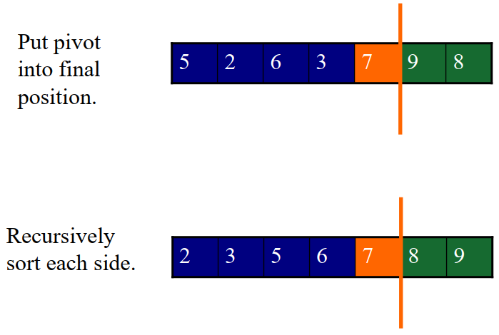
Quick Sort: Example
Sorting 7, 2, 8, 3, 5, 9, and 6 using merging sort

Slide 39
Quick Sort: Example
Partitioning on
4 3 6 9 2 4 3 1 2 1 8 9 3 5 6

Slide 40
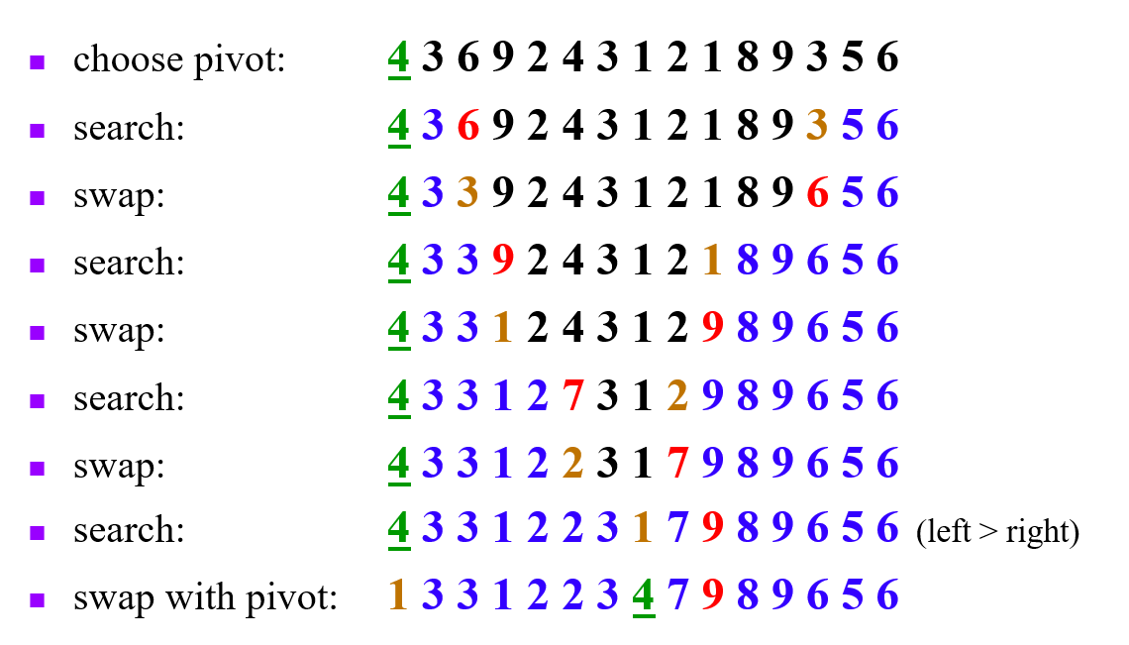
Quick Sort: Example
Partitioning on
4 3 6 9 2 4 3 1 2 1 8 9 3 5 6

Slide 41
Quick Sort Time Analysis
Picking pivot: constant time
Partitioning: linear time
Recursion: time for sorting left partition (say of size 𝑖) + time for right (size 𝑁 − 𝑖 − 1) + partition time
T(𝑁)=T(𝑖)+T(𝑁 - 𝑖 - 1)+ cN
where 𝑖 is the number of elements smaller than the pivot

Slide 42
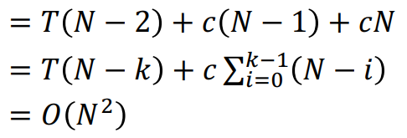
Quick Sort Worst Case
Quick Sort is fast in practice but has 𝜃(𝑁²) worst-case complexity
Pivot is always smallest element, so 𝑖 = 0:
T(𝑁) = T(𝑖)+T(𝑁 - 𝑖 - 1)+ cN
= T(𝑁 - 1)+ cN

Slide 43
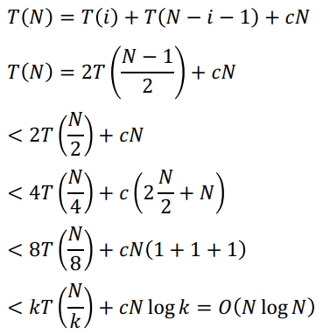

Quick Sort Best Case
Pivot is always middle element

Slide 44
Dealing with Slow Quick Sort
Randomly choose pivot
Good theoretically and practically, but call to random number generator can be expensive
Pick pivot cleverly
“Median-of-3” rule takes Median(first, middle, last element elements) as pivot. Also works well
e.g., Swap Median with either first or last element, then partition as usual

Slide 45
Integer sorting
We've already discussed that (under some more or less standard assumptions), no sort algorithm can have a run time better than 𝑛log𝑛
However, there are algorithms that run in linear time (huh???)

Slide 46
Bucket Sort
If all keys are 0 … 𝐾 − 1
Have an array of 𝐾 buckets (linked lists)
Put keys into correct bucket of array
linear time!
Bucket Sort is a stable sorting algorithm:
Items in input with the same key end up in the same order as when they began
Impractical for large 𝐾

Slide 47
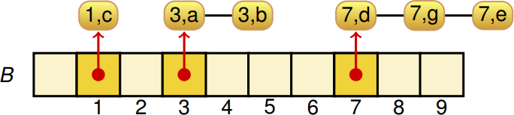
Bucket Sort: Example
Key range [0, 9]
Phase 1: filling the buckets
Phase 2: emptying the buckets into the list

Slide 48
Bucket Sort Time Analysis
Phase 1 takes 𝑂(𝑛) time
Phase 2 takes 𝑂(𝑛 + 𝐾) time
Thus bucket-sort is 𝑂(𝑛 + 𝐾)
Very efficient if keys come from a small interval [0, 𝐾 − 1]

Slide 49
Radix Sort
Radix = “The base of a number system” (Webster’s dictionary)
Alternate terminology: radix is number of bits needed to represent 0 to base 1; can say “base 8” or “radix 3”
Idea: Bucket Sort on each digit, bottom up

Slide 50
The Magic of Radix Sort
Input list:
126, 328, 636, 341, 416, 131, 328
Bucket Sort on lower digit:
341, 131, 126, 636, 416, 328, 328
Bucket Sort result on next-higher digit:
416, 126, 328, 328, 131, 636, 341
Bucket Sort that result on highest digit:
126, 131, 328, 328, 341, 416, 636

Slide 51
Running Time of Radix sort
𝑛 items, 𝑑 digit keys
How many passes?
How much work per pass?
Total time?

Slide 52
Running Time of Radix sort
𝑛 items, 𝑑 digit keys
How many passes? d
How much work per pass? n
Total time? O(dn)

Slide 53
Summary
 | Best | Average | Worst
Insertion sort | 𝑂(𝑛) | 𝑂(𝑛²) | 𝑂(𝑛²)
Selection sort | 𝑂(𝑛²) | 𝑂(𝑛²) | 𝑂(𝑛²)
Heapsort | 𝑂(𝑛 log 𝑛) | 𝑂(𝑛 log 𝑛) | 𝑂(𝑛 log 𝑛)
Merge sort | 𝑂(𝑛 log 𝑛) | 𝑂(𝑛 log 𝑛) | 𝑂(𝑛 log 𝑛)
Quick sort | 𝑂(𝑛 log 𝑛) | 𝑂(𝑛 log 𝑛) | 𝑂(𝑛²)
Bucket sort | 𝑂(𝑛 + 𝑘) | 𝑂(𝑛 + 𝑘) | 𝑂(𝑛 + 𝑘)
Radix sort | 𝑂(𝑑𝑛) | 𝑂(𝑑𝑛) | 𝑂(𝑑𝑛)

